Slide 1
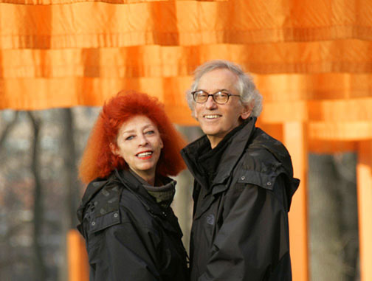
Christo and Jean-Claude

Slide 2
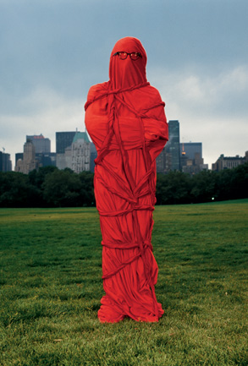

Slide 3
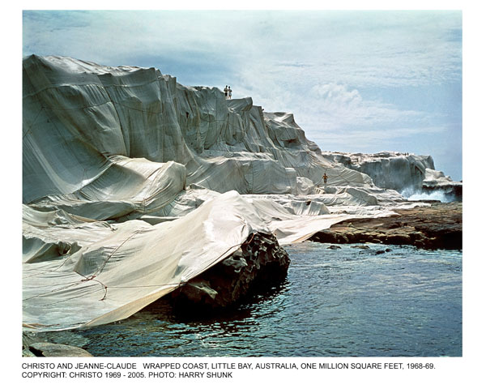
Wrapped Coast, Little Bay, Australia, One Million Square Feet, 1968-69

Slide 4
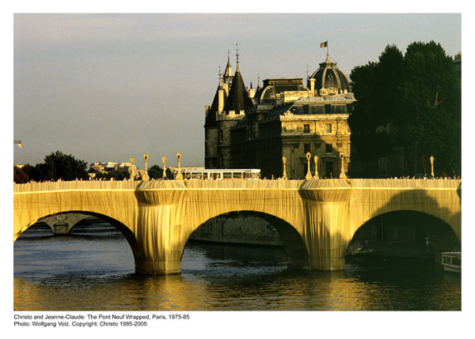

Slide 5
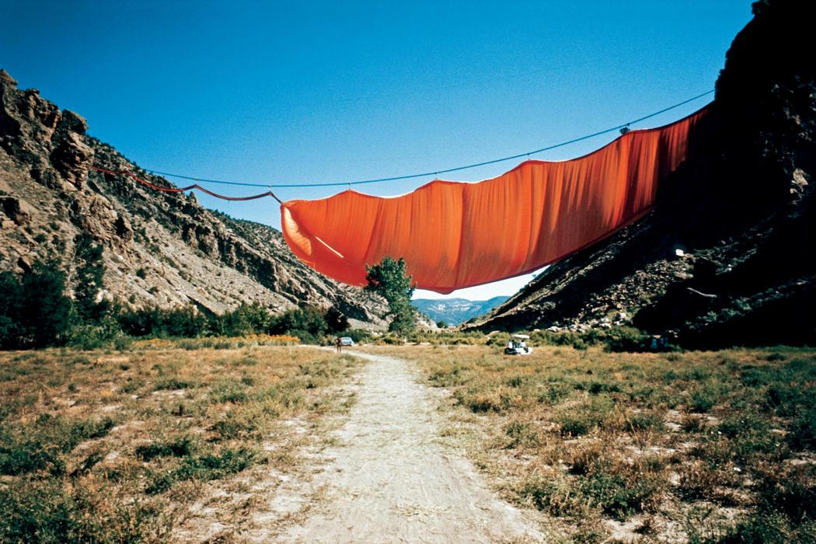

Slide 6
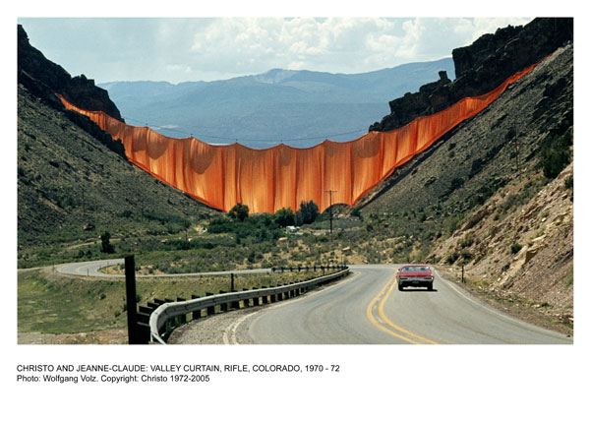
Valley Curtain, Rifle, Colorado, 1970-72

Slide 7
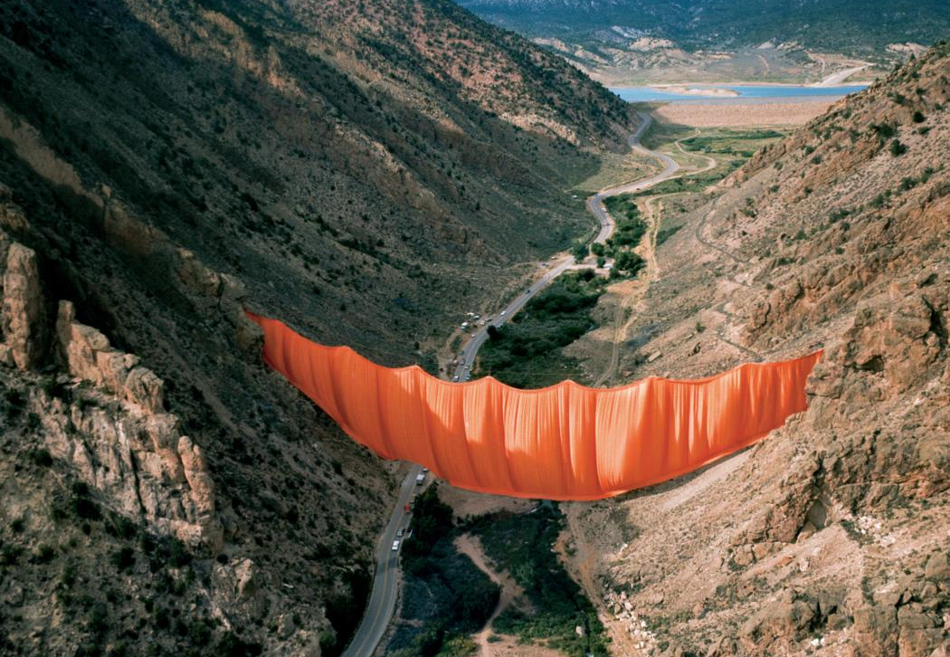

Slide 8
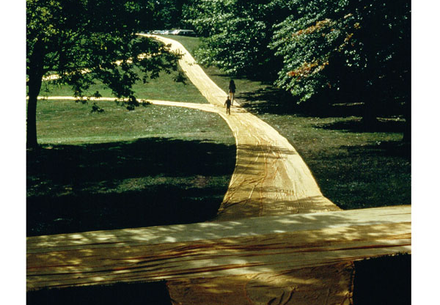
Christo and Jeanne-Claude: Wrapped Walk Ways, Jacob Loose Park, Kansas City, Missouri, 1977-78

Slide 9
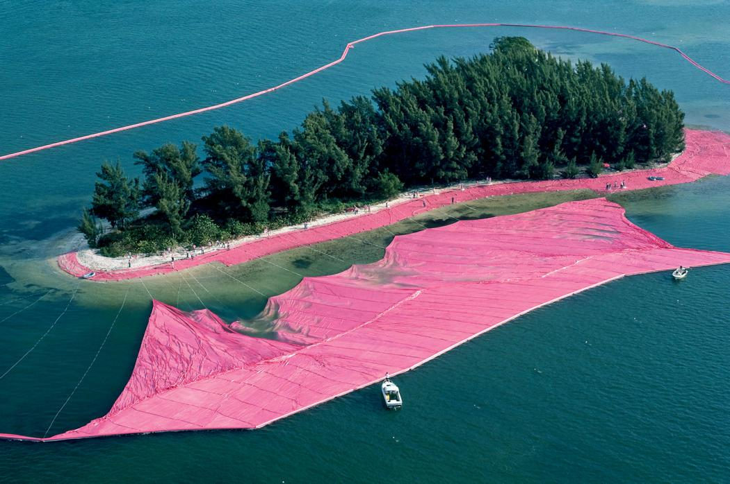

Slide 10
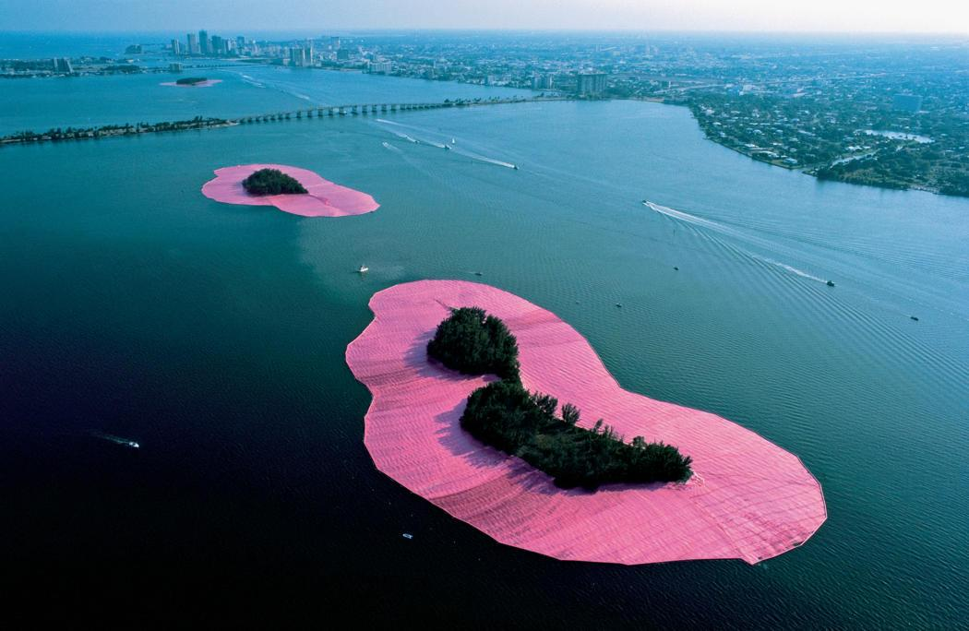

Slide 11
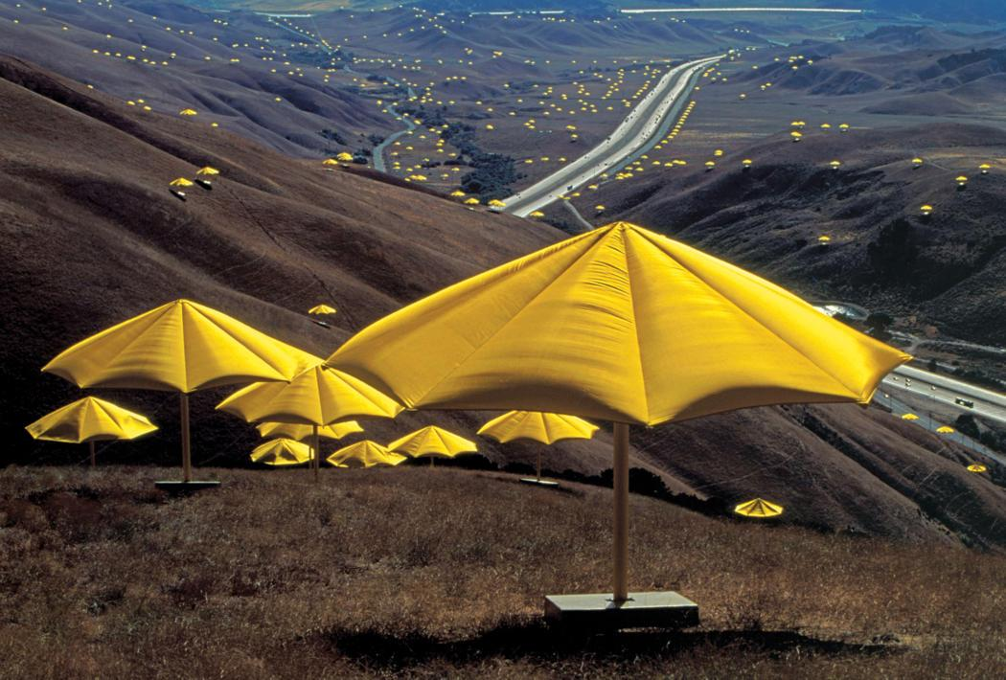

Slide 12
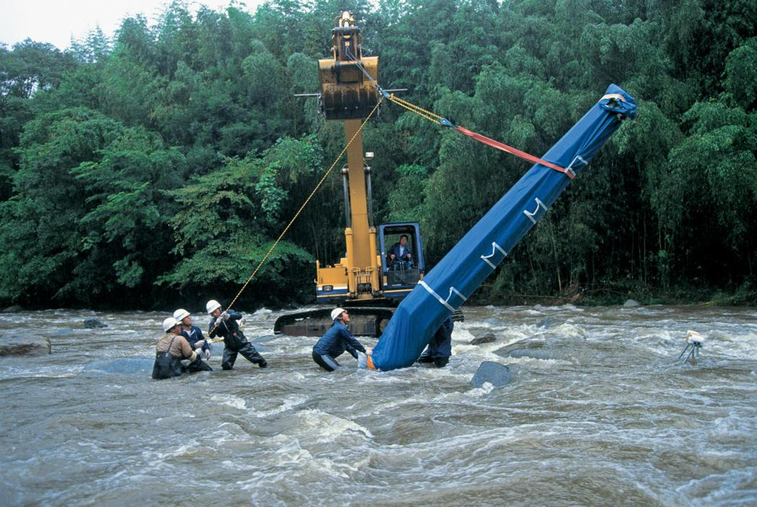

Slide 13
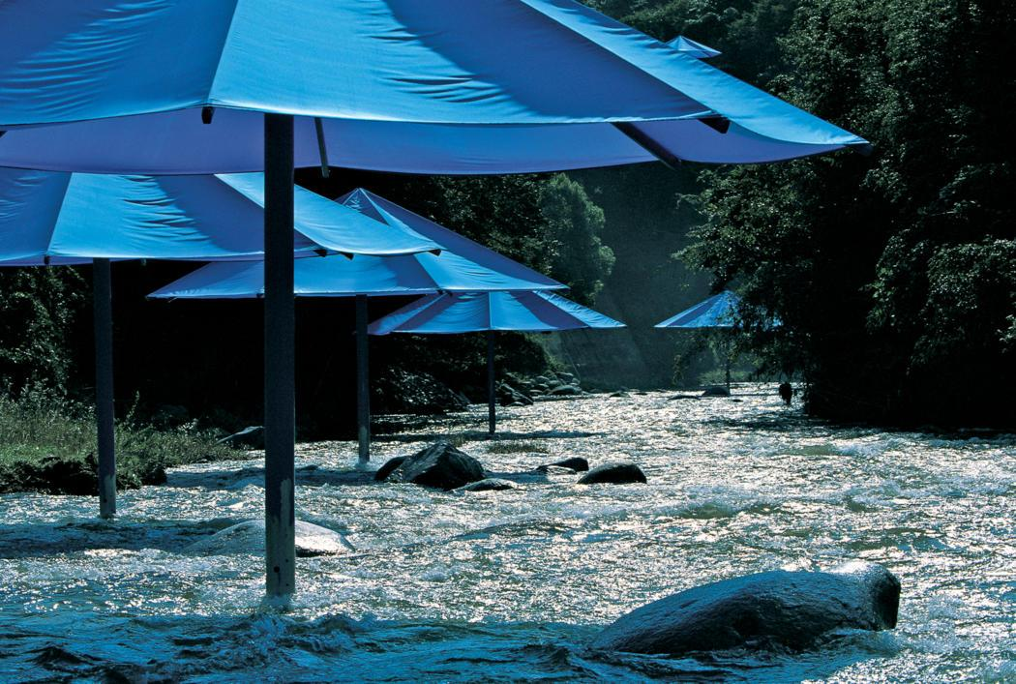

Slide 14
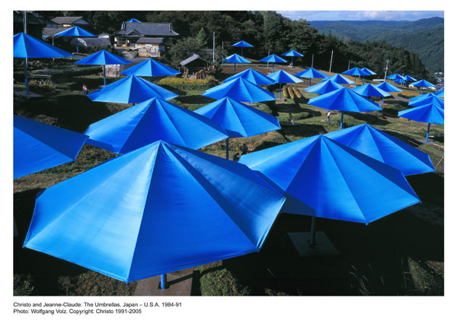

Slide 15
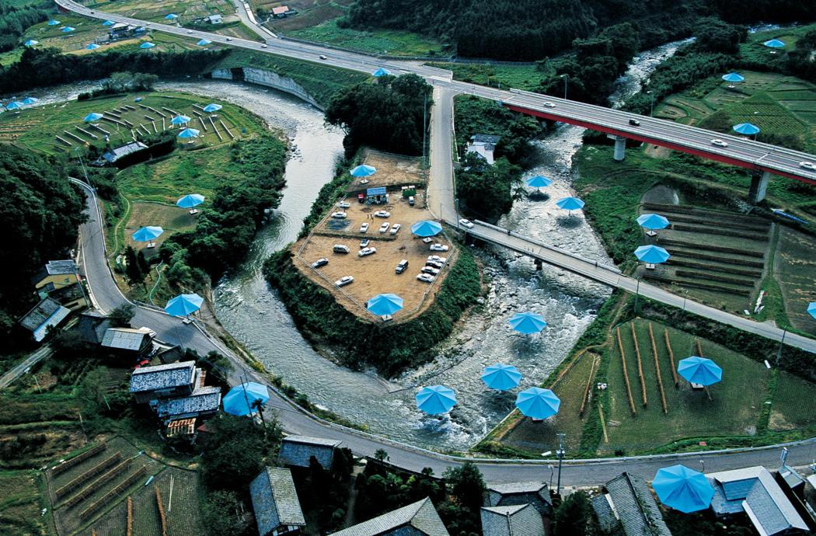

Slide 16
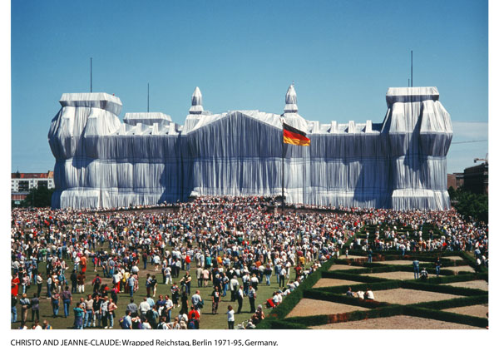

Slide 17
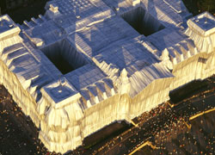

Slide 18
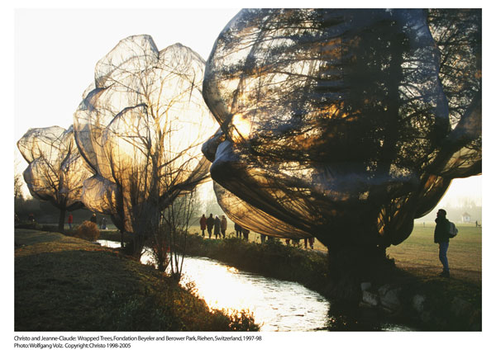

Slide 19
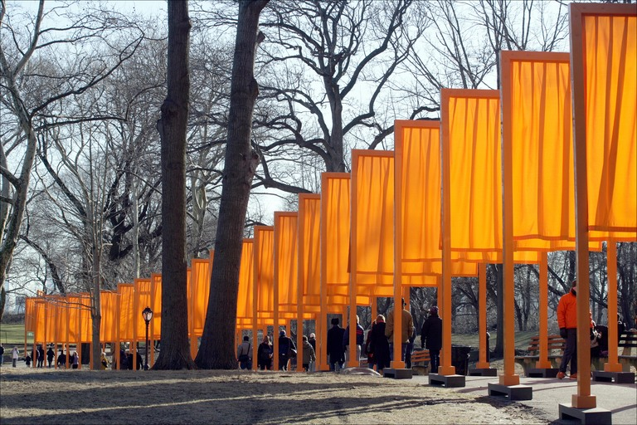

Slide 20
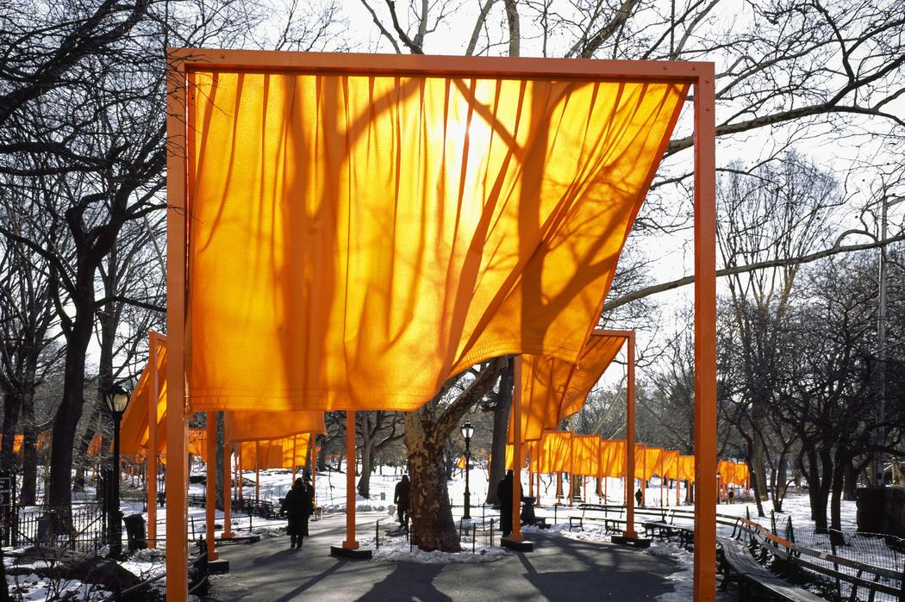

Slide 21
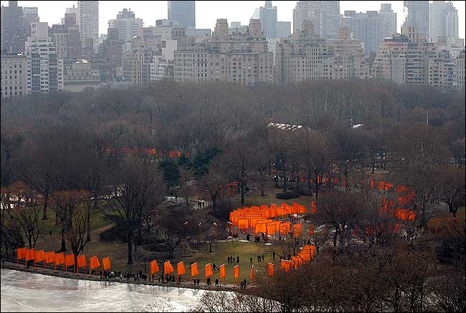

Slide 22
The artists Christo and Jeanne-Claude were born in the same hour on the same day, June 13, 1935. Christo in Bulgaria and Jeanne-Claude in Casablanca, Morocco. They met in Paris in 1958 and in 1964, moved to New York, which has been their home ever since.
Their art has been displayed on four continents and seen by millions.
Christo began to wrap objects in 1958, using everyday objects such as shoes, telephones and empty paint cans. Wrapping them made viewers focus on the shape and form of the object by covering it up
Our works are temporary in order to give them a feeling of urgency to be seen, because they will not last, and the special attention that is given to temporary things
Christo and Jeanne-Claude started wrapping later on a much larger scale. The details of the structures are hidden, making the big, solid structure seem airy. The fabric also gives the work a fragile character.
Christo and Jeanne-Claude's larger works are entire environments. The artists temporarily use one part of the environment, encouraging viewers to see it differently. The effect lasts longer than the actual work of art- years after seeing the work, visitors can still see and feel them in their minds when they return to the sites
Valley Curtain was installed between two Colorado mountain slopes in 1972. The orange curtain was made from 200,200 square ft of fabric. 28 hours after completion, a gale made it necessary to start the removal.
Wrapped Walk Ways, Kansas City, Missouri, consisted of the installation of saffron-colored nylon fabric covering 2.7 miles of formal garden walkways and jogging paths.
The Umbrellas in two countries at the same time reflected the similarities and differences in the ways of life and the use of the land in two inland valleys in Japan and the USA.

Slide 23
The Gates was in Central Park February 12 - February 27, 2005.- 10 years ago
They chose Central Park because when their son was a little boy they used to take him to Central Park every day—he loved to climb the beautiful rocks
7,500 gates, 16 feet high with a width varying from 5 feet 6 inches to18 feet along 23 miles of footpaths in the park, hanging down 7 feet above ground
The Gates created a visual golden river appearing and disappearing through the bare branches of the trees, highlighting the shapes of the footpaths.
The moving fabric is a symbol of the curving walkways and the rectangular poles represent the grid of City blocks around the park.
The Gates was financed entirely by the artists, who do not accept sponsorships

